Slide 1
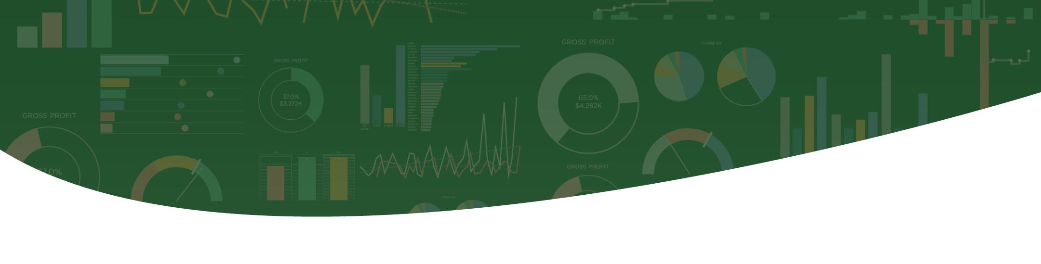

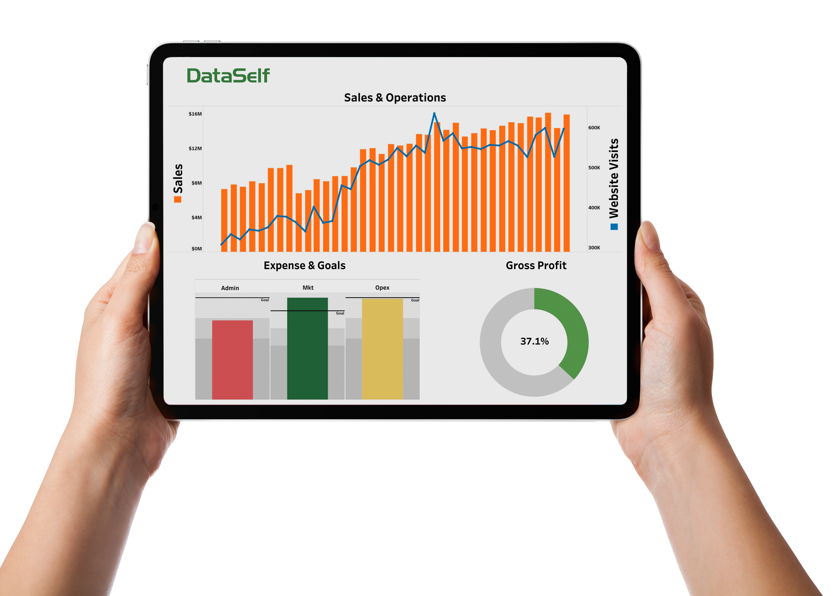
Actionable Intelligence
via DataSelf Analytics
Copyright © 2022 DataSelf Corporation. All rights reserved. DataSelf is a trademark of DataSelf Corp.
All other marks and images belong to their respective owners and the descriptive use of such marks and images does not
indicate that such respective owners are in any way connected to or endorsing DataSelf Corp or its initiatives.

Slide 2
Why Analytics? (& Why DataSelf?)
Analytics give you a number of things that standard reports don’t.
Represent your data visually
Consolidate multiple reports & spreadsheets
Analyze conditions between multiple apps/sources
DataSelf Analytics gives you a number of things that other analytics don’t.
Progressive drill-down
NLQ – “Natural Language Query”
Optimized data retrieval (avg report runtime < 1 minute)
One-click perspective selection (e.g., sales by revenues, gross profit, COGS, etc.)
Say “what if . . . “ (“what if my sales increase by 15%?”)
Generate projections (“will I have enough stock 3 months down the road?”)

Slide 3
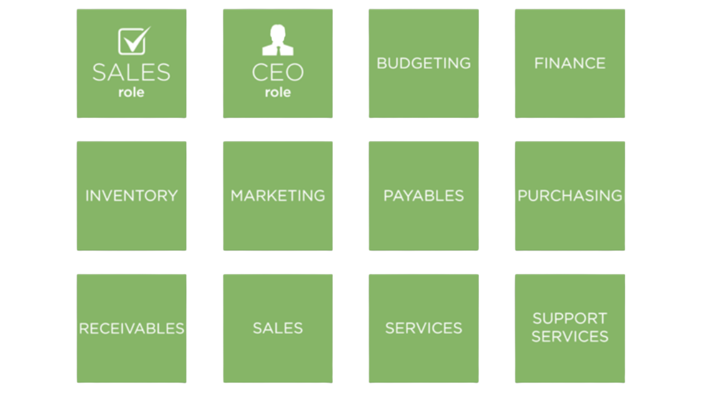

Industry & Role-Based Analytics . . .

Slide 4
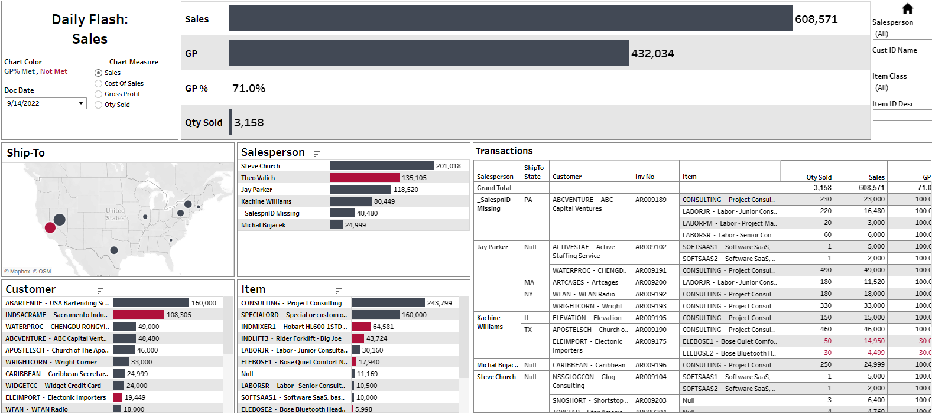
CFO: “Where do we stand?”
Are you ever challenged by . . .
. . . not knowing what’s happening right now?
. . . missing out on sales opportunities?
. . . threats to your business that go undetected?
Analytics . . .
. . . alerts you to upcoming (potential) problems.
. . . uncovers time-sensitive opportunities.
. . . lets you instantly see exactly what’s happening in
each department (sales/inventory/service, etc).

Slide 5
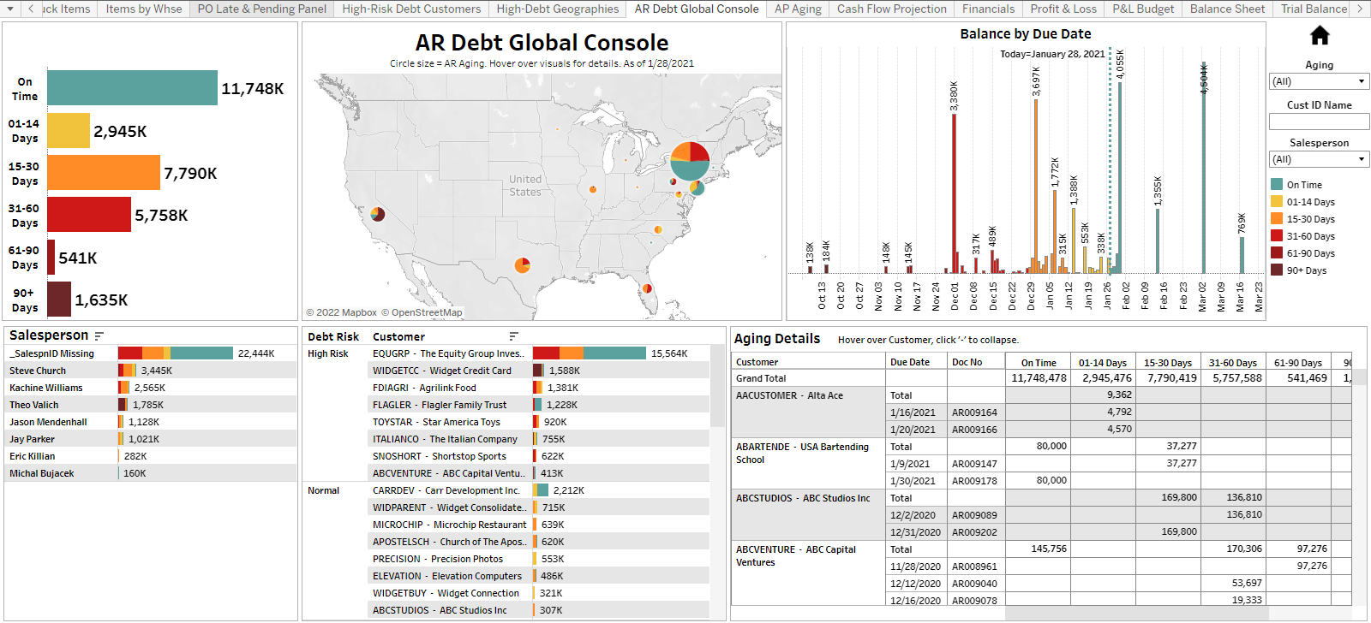
A/R: “How are our collections?”
Are you ever challenged by . . .
. . . writing off bad debt?
. . . too many invoices over 60, 90, or 120 days?
. . . not knowing who your highest-risk debt
customers are?
Analytics . . .
. . . gives you advance notice of potential bad debt.
. . . gets your clients to more quickly pay their debts.
. . . improves your ability to forecast your next 3 – 6
months incoming cash flow.

Slide 6
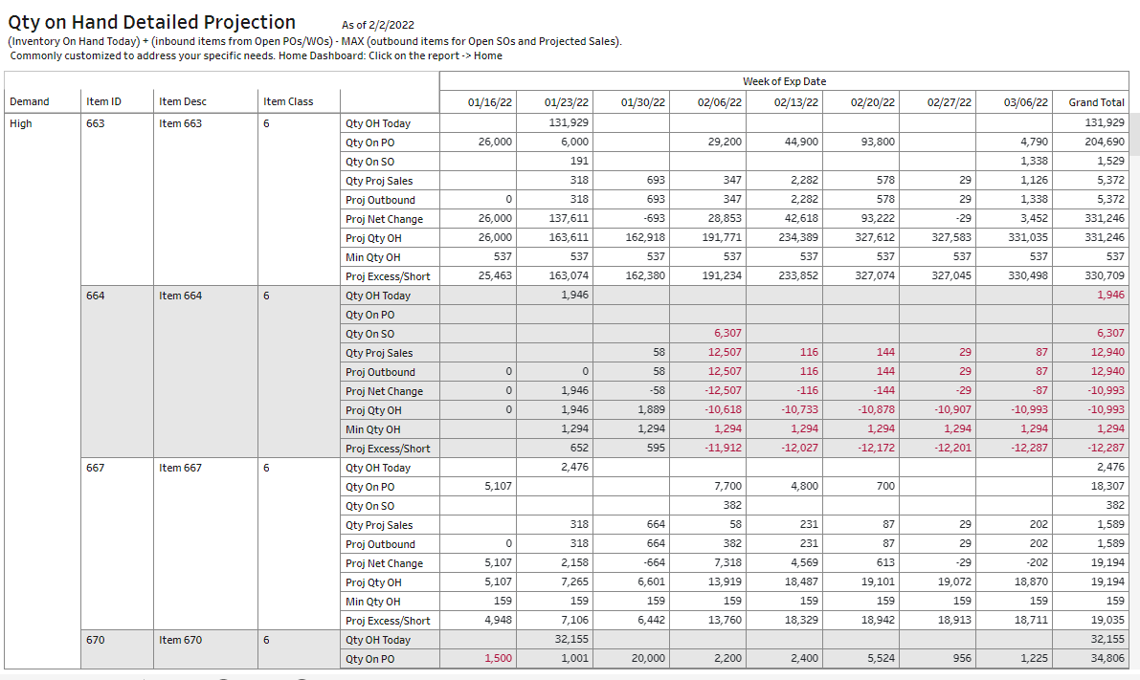
PO Mgr: “What do we need to order?”
Are you ever challenged by . . .
. . . unexpected stock outages?
. . . cancelled orders because you’re out of stock?
. . . ‘stuck’ items that restrict your cash flow and
prevent investment?
Analytics . . .
. . . predicts shortages based on past activity.
. . . reduces potential stock outages.
. . . reduces the number of backorders by enabling you to
avoid stock outages.

Slide 7
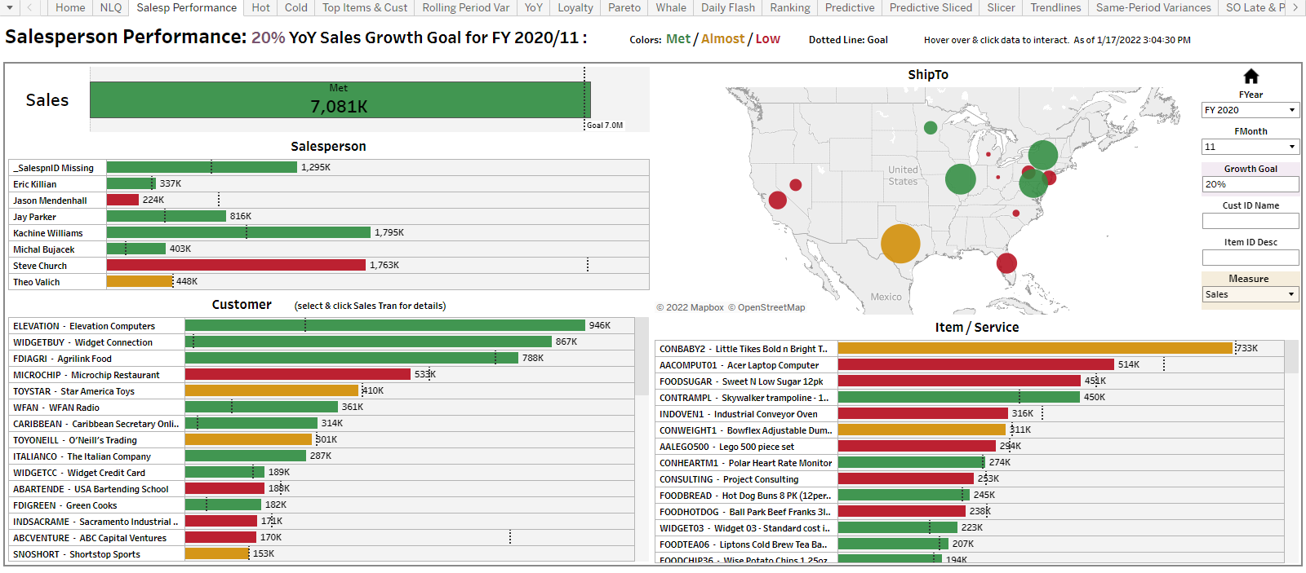
VP of Sales: “Who’s not selling?”
Are you ever challenged by . . .
. . . reps whose numbers vary greatly from month to
month without apparent reason?
. . . reps who occasionally need extra help?
. . . unexpected swings in sales based on territory,
product, or seasonal swings?
Analytics enables you to . . .
. . . better load-balance opportunities among your
sales team.
. . . identify struggling reps & provide needed assistance.
. . . more quickly identify causes for poor performance
(e.g., rep, territory, products).

Slide 8
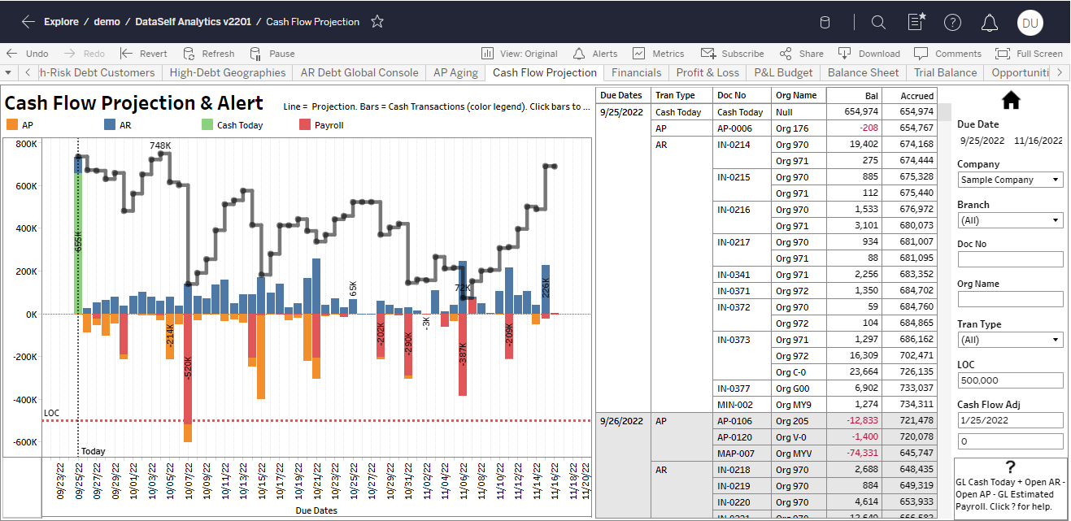
CFO: “How much is coming in?”
Are you ever challenged by . . .
. . . an inability to instantly access P&L, Cash Flow, &
Balance Sheets?
. . . waiting for someone in IT to run these analyses?
. . . Not being able to run your own custom budget-to-
actual reconciliations?
Analytics gives you . . .
. . . instant access to all the reports they need.
. . . drill-down to the details behind their reports.
. . . plain-English commands to request the precise
analyses they require.

Slide 9
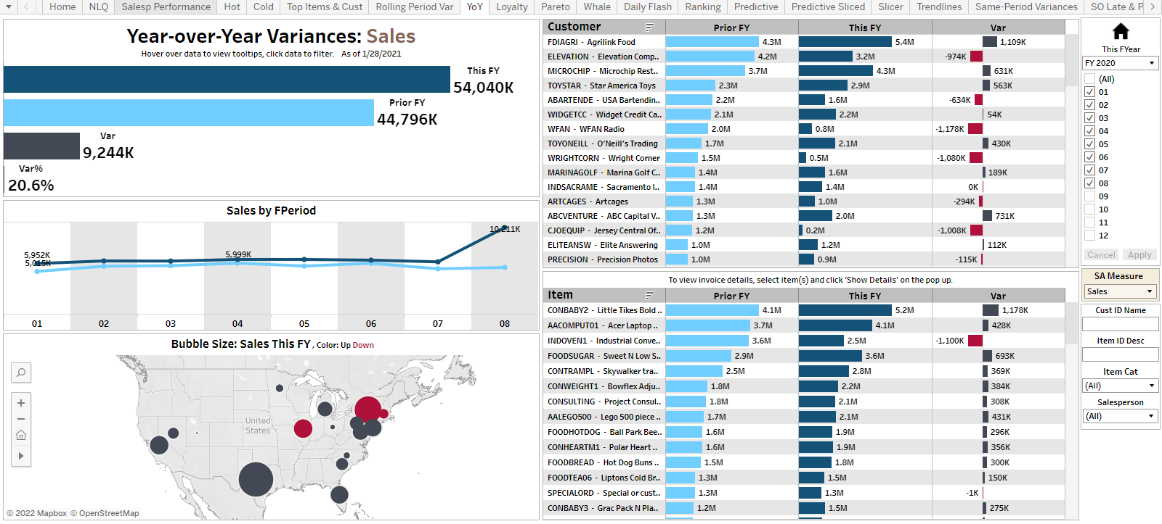
CEO: “Are we doing better or worse?”
Are you ever challenged by . . .
. . . not knowing how you’re doing this year, month or
week vs last?
. . . not having insight into which clients, products,
salesreps, or regions are doing better or worse?
Analytics gives your executives . . .
. . . real-time access to decision-making details
. . . the confidence to make decisions based on hard facts
and not hunches or guesswork.
. . . a superior ability to forecast the future based on
performances in the past.

Slide 10
The 3 things that make
DataSelf Analytics different. . .& better

Slide 11
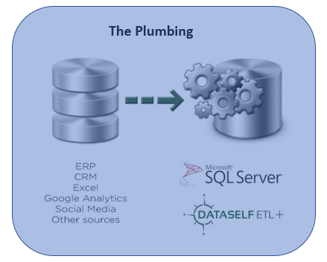
The Best Data Optimization:
Via DataSelf ETL+
BI technologies rely on secure, efficient access to highly optimized ("transformed") data. This is the "plumbing" that sits behind every BI implementation.
DataSelf offers the most advanced data extraction, transfer, & load (“ETL”) tool on the market today, with its ETL+™ patented technology.
ETL+ not only simplifies report creation, it ensures the fastest retrieval of analytic data, with the average report running in < one minute.

Slide 12
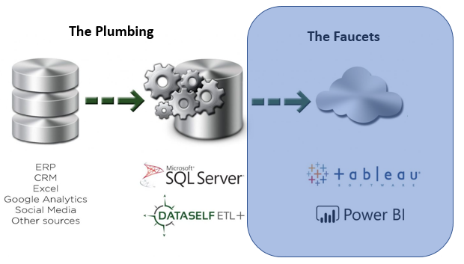
The Best BI Engines:
Via Tableau & Power BI
The analytics industry offers a wide variety of business intelligence engines. Two of them have been consistently rated at the top of the list: Tableau™ & Power BI™.
These engines not only provide the most powerful search and retrieval technologies, but also the user interface that your staff relies on.
DataSelf gives you the choice of either of these
BI engines – ensuring that you have the best to work with today . . . and for years in the future.

Slide 13
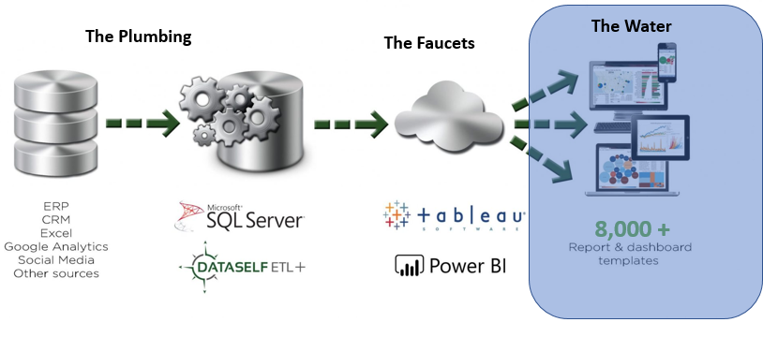
The Best Analytics Library:
Via 8,000+ Reports & Dashboards
An Analytics solution is only as good as the analytical reports & dashboards in it. DataSelf provides you with an industry-best library of over 8,000 KPI-driven samples, ready for your use.
These examples are organized by industry and role, ensuring that each member of your staff can select (and customize, if desired) the precise insight they need to make the best possible business decisions.

Slide 14









DataSelf Works with Everyone . . .

Slide 15

Demo:
DataSelf Analytics

Slide 16
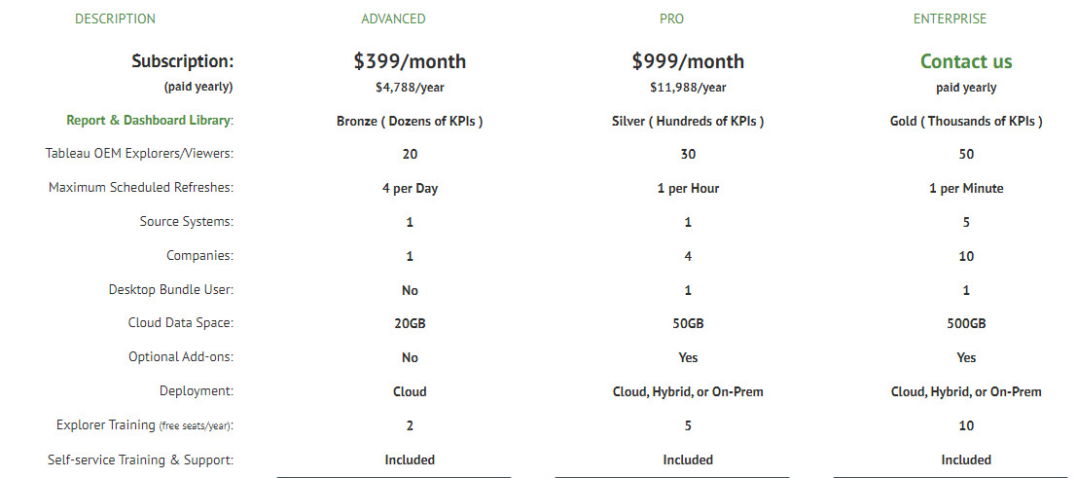
Licensing & Pricing

Slide 17
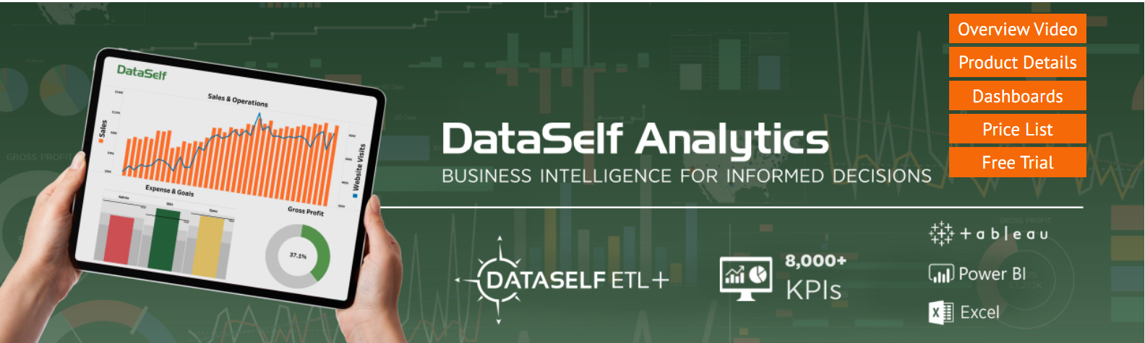
Next Steps . . .

